Slide 1

BLOCK CODING LEARNER
Session 45
Event Handlers

Slide 2

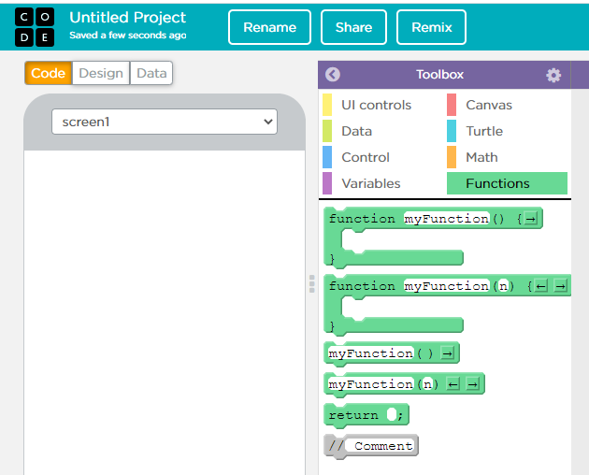
Recall…
What we have learnt in last session
What challenges you are facing

Slide 3
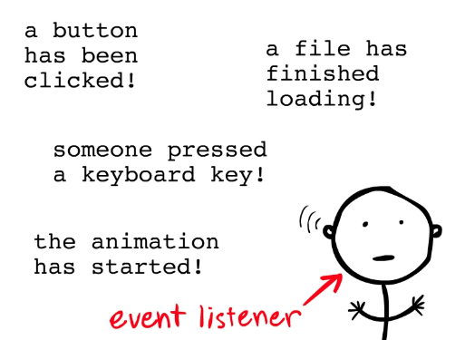
Event Handlers…
We will Learn today:
What is Event Handler
Use two click event handler in an app

Slide 4
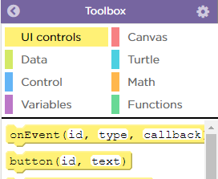
Event Handlers…
Interactive apps need both UI elements & event handlers
The UI element, with unique id, must exist before the onEvent function can be used
onEvent (id, type, callback) - Executes the callback code when a specific event type occurs for the specified UI element id

Slide 5
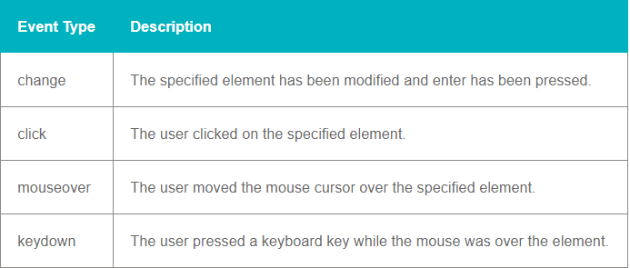
Event Types…

Slide 6
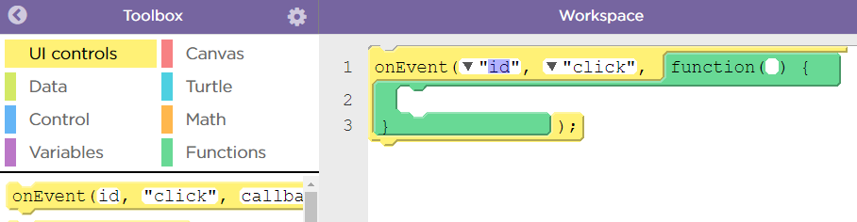
Event Handlers…
Switch into Code Mode and Drag an onEvent block from the toolbox into the workspace
From the pulldown menu select the ID of the UI element you want to respond to some event and the type of event you want to respond to
Add code inside the function that you want to run when the user triggers the event

Slide 7
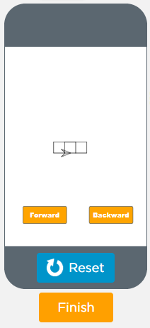
Event Handlers…
Make the turtle move forward when the button is clicked.
Add an onEvent block
Set the id of your button
Add moveForward to the function definition
Run the program to make sure it works.
Try changing the event type to something like "mouseover" and see what happens. Not all event types will work with buttons but it's fun to play a little bit.

Slide 8
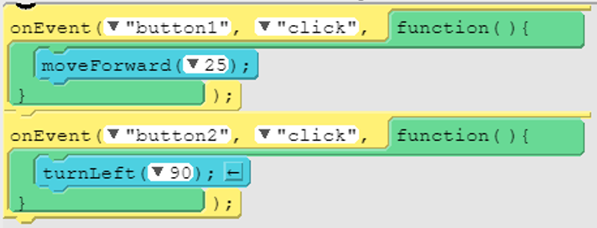
Event Handlers…
Code...

Slide 9
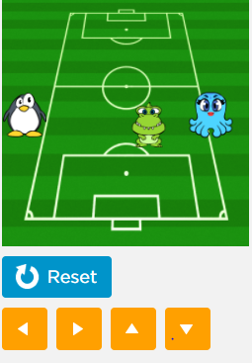
Now It’s Your Turn ?
Add a block to score a point when the Penguin runs into Octopus the when run event to change the background scene and the speed of Waddles the Penguin
Play the game and move the Penguin with the arrow keys until you score

Slide 10
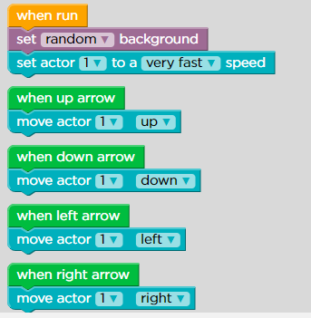
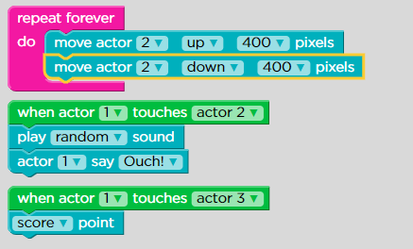
Code…

Slide 11
Event Listener Output…

Slide 12

Summary…
What is Event Handler
Use two click event handler in an app

Slide 13

Next Session…
Intent:
Learn what is Intent
Perform a task with Intent

